Slide 1
LAB 06
Exercise
2023.04.19
Presenter: Tzu-Yun, Yen

Slide 2
Outline
Topic Review
Soft IP
Extended Euclidean Algorithm
Design
Optimization
Top Module
Data Flow Graph
Optimization

Slide 3
Topic Review
Given the parameter a of an elliptic curve and two points P and Q on the curve, the task is to find the third point R s.t. P+Q+R=O, where O means an abstract point at infinity (無窮遠點).
All computations should be performed in a specific prime field (Fp).
Since we need to do the division over Fp, we need to find the inverse of the field elements, inverses can be efficiently computed by using the extended Euclidean algorithm (輾轉相除法).

Slide 4
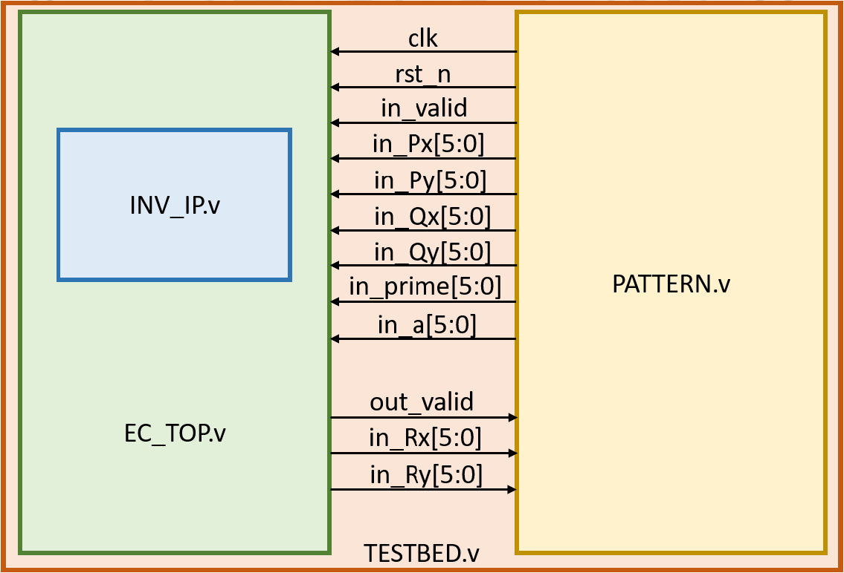
Topic Review
The design can be derived into two part:
Soft IP – compute the inverse of the field element.
Top Module – compute the coordinate of R.

Slide 5
Soft IP

Slide 6



Soft IP
The inverse of the field element b with the prime number a is defined as:
The congruence relation may be rewritten as:
We can use Extended Euclidean Algorithm to find the inverse of b. (i.e. the value of y)

Slide 7
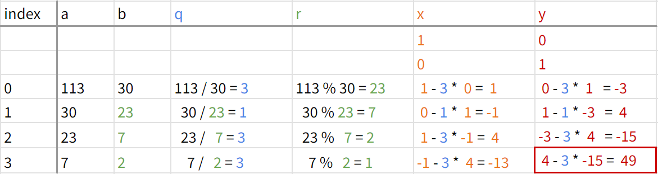
Extended Euclidean Algorithm
Extended Euclidean Algorithm Example
a = 113, b = 30
When r = 1, we get x = -13, y = 49 ⇒ inverse = 49
a*x + b*y = 113 * -13 + 30 * 49 = 1

Slide 8
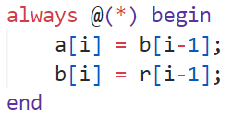
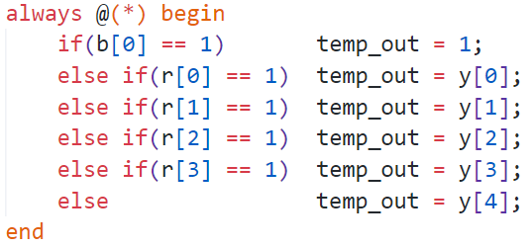
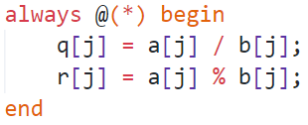
Verilog Code
compute a, b
compute y
select output
compute q, r

Slide 9
Problems in Soft IP Design
How many iterations do we need to compute inverter?
IP_WIDTH = 5 ⇒ 5 iters
IP_WIDTH = 6 ⇒ 6 iters
IP_WIDTH = 7 ⇒ 7 iters
How many bits are required for each variable?
a, b, q, r ⇒ IP_WIDTH bits (unsigned)
y ⇒ IP_WIDTH + 1 bits (signed)

Slide 10
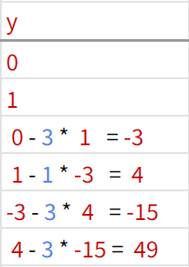
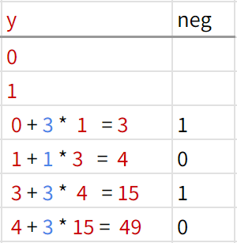
Optimization 1
Observation: The sign of y is reversed at each iteration.
Change the calculation of y to
⇒ the bit width of y can be reduced by one. (signed → unsigned)

Slide 11
Optimization 2
Observation
The inverse of b is equal to the negative of the inverse of prime - b.
One more iteration is required if b > prime/2.
Limit the field element b between 1 and prime/2
⇒ the iteration can be reduced by one.

Slide 12
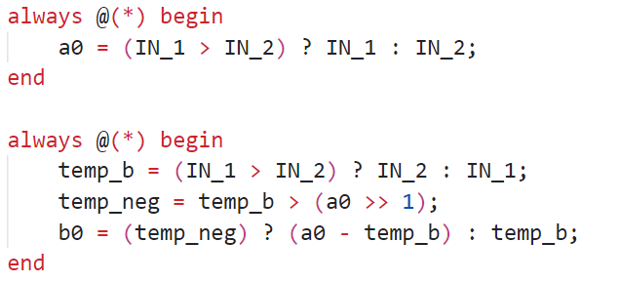
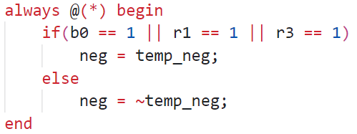
Optimization 1 & 2
Optimization 2
Optimization 1

Slide 13
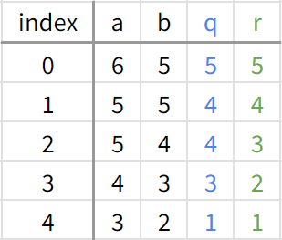
Optimization 3
For IP_WIDTH = 6, set each variable’s bit width separately.
Since the quotient of the 5th iteration can only be 1, actually, we don't need to do the 5th division
⇒ only need 4 dividers(/), 4 remainders(%), 3 multipliers(*) and 5 adders(+)

Slide 14
After Optimization
How many iterations do we need to compute?
IP_WIDTH = 5 ⇒ 4 iters
IP_WIDTH = 6 ⇒ 4 iters (+ 1adder)
IP_WIDTH = 7 ⇒ 6 iters
How many bits are required for each variable (a, b, q, r, y)?
for IP_WIDTH = 5 or IP_WIDTH = 7 ⇒ IP_WIDTH bits (unsigned)
for IP_WIDTH = 6 ⇒ set separately

Slide 15
Top Module

Slide 16

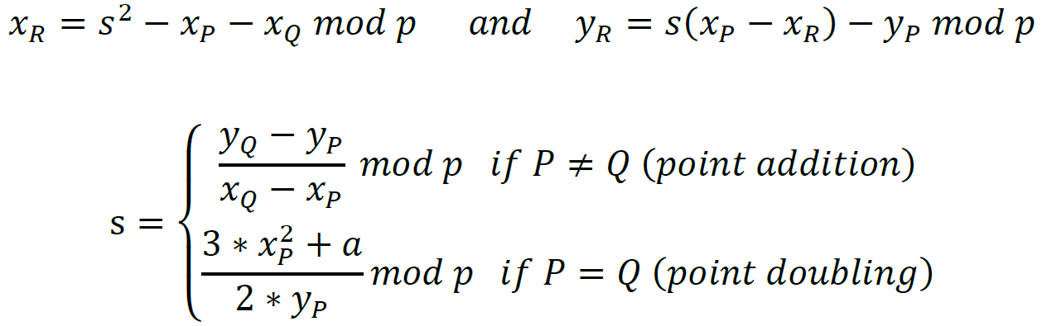
Top Module
The elliptic curve over Fp is defined as
The expressions for the group operation over prime field

Slide 17
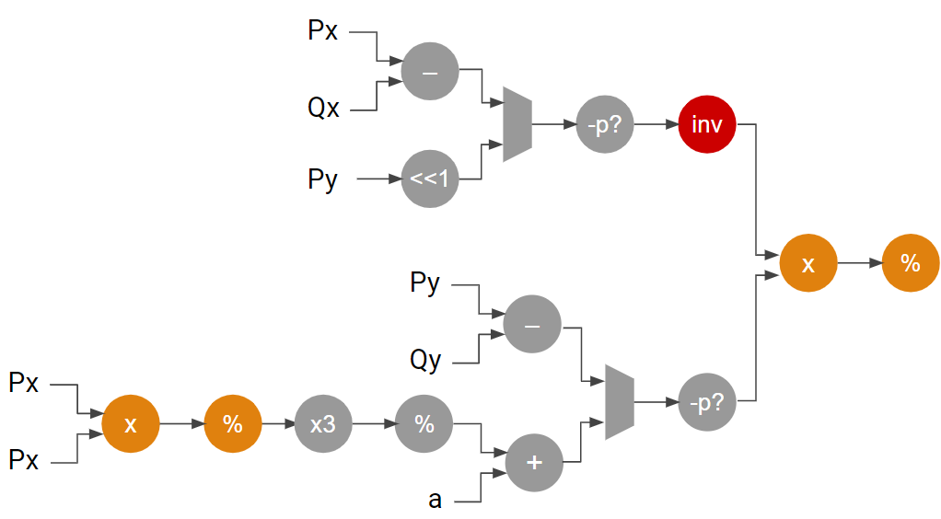
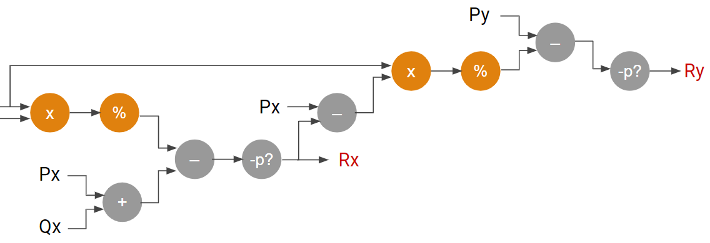
Data Flow Graph
The data flow graph is shown as below
compute s
compute Rx
compute Ry

Slide 18
Pipeline
Theoretically
pros: cycle time ⇓ & area ⇓ (∵ hardware reuse)
cons: latency ⇑
Pratically
Cycle time is limited by the longest data path.
⇒ Too many stage of pipeline will cause pipeline imbalance.
The smaller cycle time, the larger components that Design Compiler will choose.
We need extra muxs to select the input of reused hardware.
⇒ The decrease in area is not proportional to the increase in latency.

Slide 19
Optimization
Strategies
Divided into 2.5 pipeline stages
Only reuse one multiplier and one remainder in each pipeline.
clk
in_valid
(1)
(2)
(3)
out_valid
latency = 1

Slide 20

After Optimization
(1)
(2)
(3)

Slide 21
The End
Thanks for listening :)

Slide 22
Data Flow Graph
Px
–
Qx
-p?
inv
Py
<<1
Ry
x
%
Py
–
Qy
Px
-p?
x
%
x3
%
Px
+
a

Slide 23
Data Flow Graph
Py
–
x
%
-p?
Ry
x
%
Px
–
–
-p?
Rx
Px
+
Qx

